Slide 1
Advanced algorithms
Lê Sỹ Vinh
Computer science department
Email: vinhls@vnu.edu.vn

Slide 2
Outlines
Divide and conquer
Dynamic programming
Greedy algorithms

Slide 3
Dynamic programming
Consider the counting Fibonacci problem
Fibonacci numbers are defined recursively:
F₀ = 0
F₁ = 1
F_{i} = F_{i-1} ⁺ F_{i-2} for i > 1.
A naïve recursive algorithm:
Algorithm BinaryFib(k):
if (k < 2) then
return k;
else
return BinaryFib(k - 1) + BinaryFib(k - 2);

Slide 4
Analyzing the Binary Recursion Fibonacci Algorithm
Let n_{k} denote number of recursive calls made by BinaryFib(k).
n₀ = 1
n₁ = 1
n₂ = n₁ + n₀ + 1 = 1 + 1 + 1 = 3
n₃ = n₂ + n₁ + 1 = 3 + 1 + 1 = 5
n₄ = n₃ + n₂ + 1 = 5 + 3 + 1 = 9
n₅ = n₄ + n₃ + 1 = 9 + 5 + 1 = 15
n₆ = n₅ + n₄ + 1 = 15 + 9 + 1 = 25
n₇ = n₆ + n₅ + 1 = 25 + 15 + 1 = 41
n₈ = n₇ + n₆ + 1 = 41 + 25 + 1 = 67.
The value n_{k} is exponential!

Slide 5
Dynamic programming
It employs divide and conquer strategy.
It stores the solutions of all smaller problems so each smaller problem is solved once.
It is usually used to solve optimization problems.

Slide 6
Fibonacci
int fib[N];
for (int i = 0; i ≤ N; i ++)
fib[i] = -1;
fib[0] = 0;
fib[1] = 1;
Int Fibonacci (int k):
if (fib[k] == -1)
fib[k] = Fibonacci (k-1) + Fibonacci (k-2);
return fib[k];

Slide 7
Dynamic programming template
Find solutions for base problems
Find the method to solve problem from smaller problems
Design data structure to store solutions of problems
Find the solutions from smaller problems to bigger problems

Slide 8
Dynamic programming problems (http://people.csail.mit.edu/bdean/6.046/dp/)
Given a sequence of n integer numbers A(1) ... A(n), your task is to find a contiguous subsequence A(i) ... A(j) for which the sum of elements in the subsequence is maximized.
Given a sequence of n integer numbers A(1) ... A(n), your task is to find the longest subsequence (not necessarily contiguous) in which the values in the subsequence form a strictly increasing sequence.

Slide 9
Dynamic programming problems (http://people.csail.mit.edu/bdean/6.046/dp/)
Given two text strings A and B, we can transform string A to string B using following operations:
delete a character from A
insert a character into A
change some character in A into a new character.
The minimal number of such operations required to transform A into B is called the edit distance between A and B.
Your task is to find the edit distance between A and B.

Slide 10
Edit distance
Input: Strings A[1..n] and B[1..m]
Costs C_{i} C_{d} C_{r}
Insertion Deletion Replacement
Goal: Compute minimum cost of transforming A → B
T(i, j): Minimum cost to transform A[1..i] into B[1..j]
C_{d} + T(i-1, j)
T(i, j) = min T(i, j-1) + C_{i}
T(i-1, j-1) if A[i] = B[j]
T(i-1, j-1) + C_{r} if A[i] != B[j]

Slide 11
Greedy algorithms
A majority real-world problem is optimization problems
Good solutions versus optimal solutions
Greedy algorithms work in different phases. At each phase, we take the locally optimal choices.

Slide 12
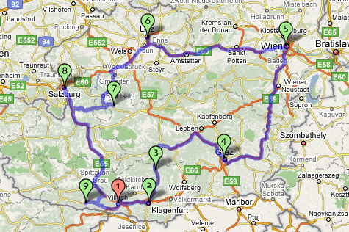
Traveling salesman problem (TSP)

Slide 13
Traveling salesman problem (TSP)
Nearest neighbor algorithm: From the current city, visit the nearest unvisited city. Repeat the process until all cities have been visited, then return to the start city.

Slide 14
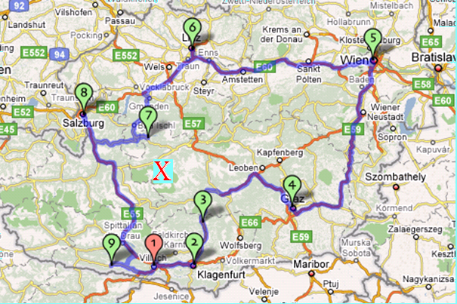
Traveling salesman problem (TSP)
Nearest neighbor path:
1 → 2 → 3 → X → 7 → 8 → 6 → 5 → 4 → 9 → 1
Optimal path:
1 → 2 → 3 → 4 → 5 → 6 → 8 → 7 → X → 9 → 1

Slide 15
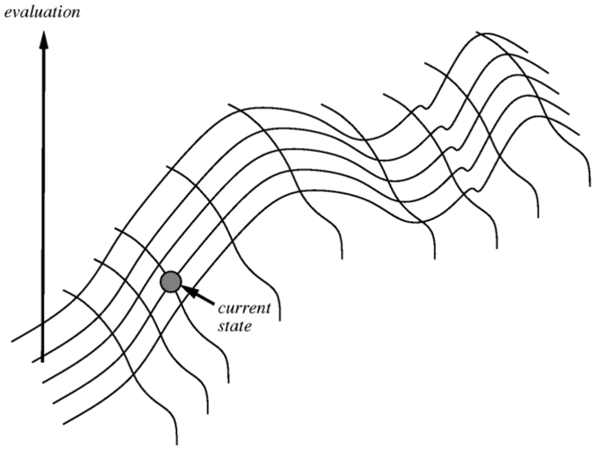
Hill climbing strategy
Start from a solution, then iteratively change the current solution to get a better one.

Slide 16
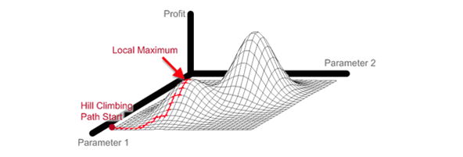
Hill climbing strategy

Slide 17
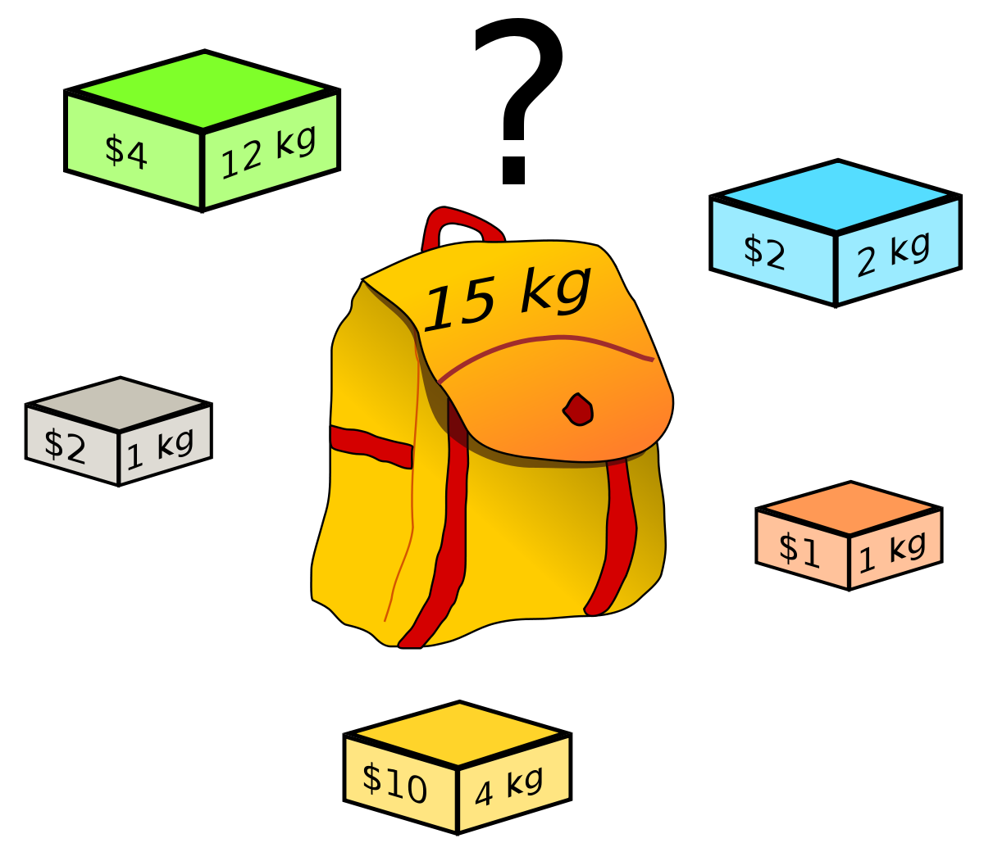
Knapsack problem

